Slide 1
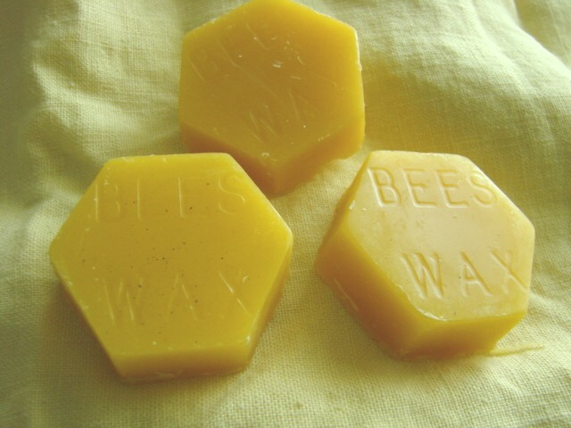
Beeswax & Candles
Pat Bono, RochesterBeekeepers.com

Slide 2
Beeswax candles were already used by the ancient Egyptians, ancient Greeks, and in Rome and China. Beeswax candles have been used in European churches since the beginning of Christianity. The Roman Catholic Church only allowed beeswax candles to be used in the church. Although this law is still valid today, candles are no longer required to be 100 percent beeswax. By the eleventh century, however, churches were using huge amounts of candles. They were able to maintain the necessary amount of beeswax in part by having apiaries in every monastery and abbey.
In the days of Marco Polo, beeswax was abundant and was often used to pay tribute to kings. But despite its abundance, beeswax candles were only in the hands of the rich; the poor had to suffer with tallow candles.
It was not until the middle ages that the history of beeswax takes an innovative turn. Candles made of beeswax prove to be of superior quality when compared with tallow candles, as they burned clean, and free of odor and smoke.

Slide 3
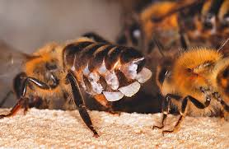
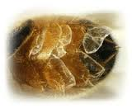
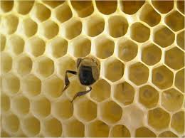

Slide 4
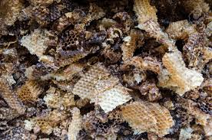

Slide 5
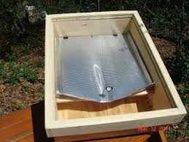
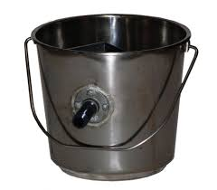
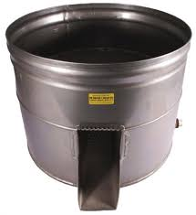

Slide 6
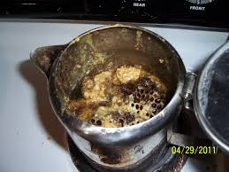
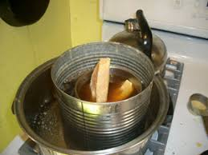
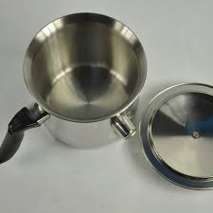
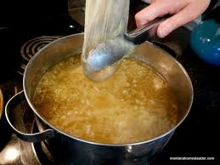

Slide 7
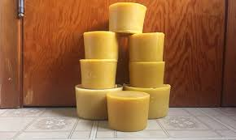
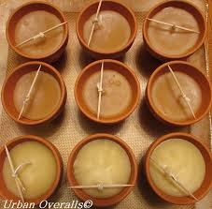
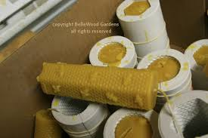

Slide 8
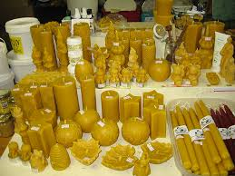
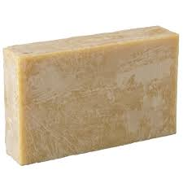

Slide 9
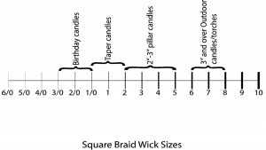

Slide 10
https://www.beeculture.com/the-right-size-wick/
https://www.kelleybees.com/blog/kelley-beekeeping/making-beeswax-candles/

